Slide 1
GETTING INVOLVED IN RESEARCH
SASC PREHEALTH GROUP

Slide 2
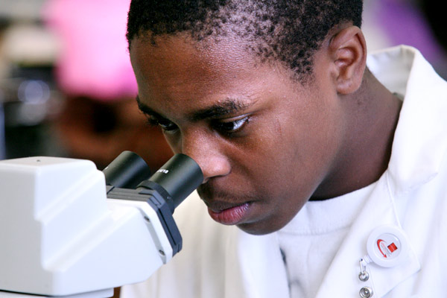
What is research and Why IS it important?
http://youtu.be/FuVGo3AJhqA

Slide 3
How do I Keep up to date?
Read about current research going on throughout our campus and even throughout the world.
http://www.journalcra.com/current-issue
http://www.ijcrr.com/
http://www.colorado.edu/research

Slide 4
Where Do I start?
In your science classrooms!
Almost all (if not all) science professors are involved in a lab or even lead one
Go to office hours to get to know your professor outside of class
Talk to professor about lab
What you are interested in
What research his lab is focusing on
Volunteer!

Slide 5
How We did it!
Now let’s hear how fellow students have gotten involved
Students who have not will share their plans of getting involved

